Slide 1
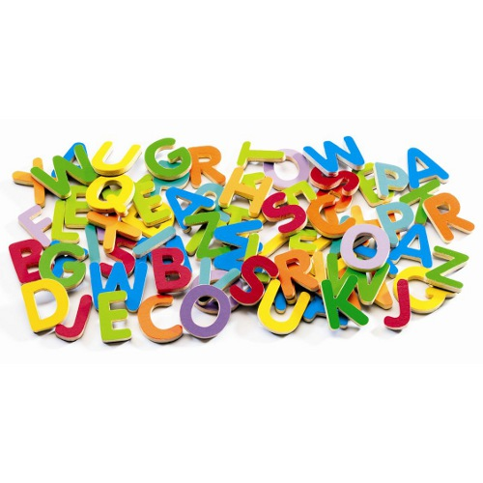

Phonics screening test 2021 -22
Parent video: The Phonics Screening Check

Slide 2

The Phonics Screening Check is meant to show how well your child can use the phonics skills they’ve learned up to the end of Year 1, and to identify students who need extra phonics help.

Slide 3
The checks consist of 40 words and non-words that your child will be asked to read one-on-one with a teacher.
Non-words (or nonsense words, or pseudo words) are a collection of letters that will follow phonics rules your child has been taught. Your child will need to read these with the correct sounds to show that they understand the phonics rules behind them.

Slide 4
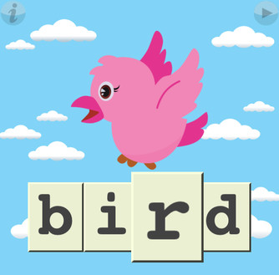
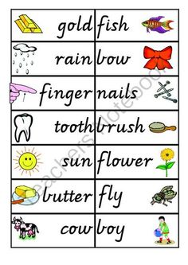
The 40 words and non-words are divided into two sections – one with simple word structures of three or four letters, and one with more complex word structures of five or six letters.

Slide 5
Simple word structures
hab
chob
pot
back
feet
nurt

Slide 6
Complex word structures
blies
keam
whape
rice
midnight
glued

Slide 7

Each of the non-words is presented with a picture of a monster / alien, as if the word were their name (and so your child doesn't think the word is a mistake because it doesn't make sense!).

Slide 8
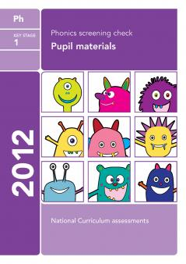
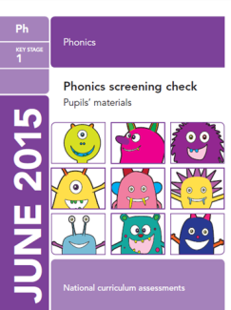
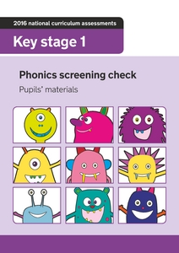
You can download past papers to get an idea of what your child will be asked to do.
https://www.youtube.com/watch?v=46SyC6bZOF8

Slide 9
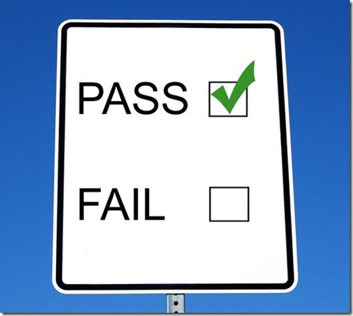
Your child will be scored against a national standard, and the main result will be whether or not they fall below, within or above this standard.
since 2013 the pass rate has been 32' however the pass rate is not announced until after the screening. This means children had to read at least 32 words out of 40 correctly.

